Slide 1
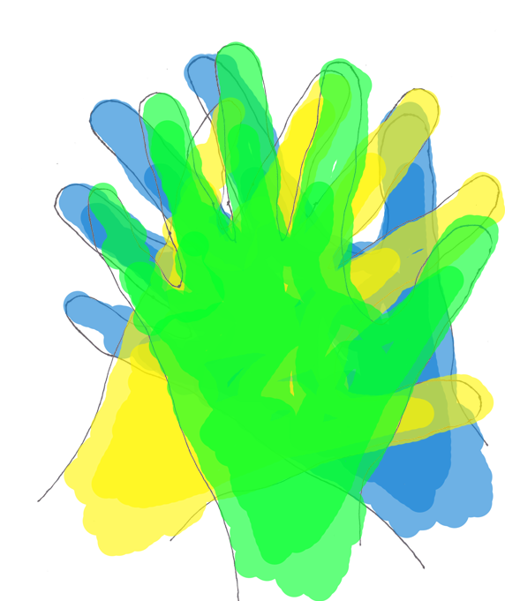
Demonstrating Cultural Acceptance Through External and Internal Wayshowing
Team D: Casey Addy, Lynn Dombrowski, Varun Khanduja, Susan Coleman Morse

Slide 2
Table of Contents
Predispositions
Research
Insights
Prototypes

Slide 3
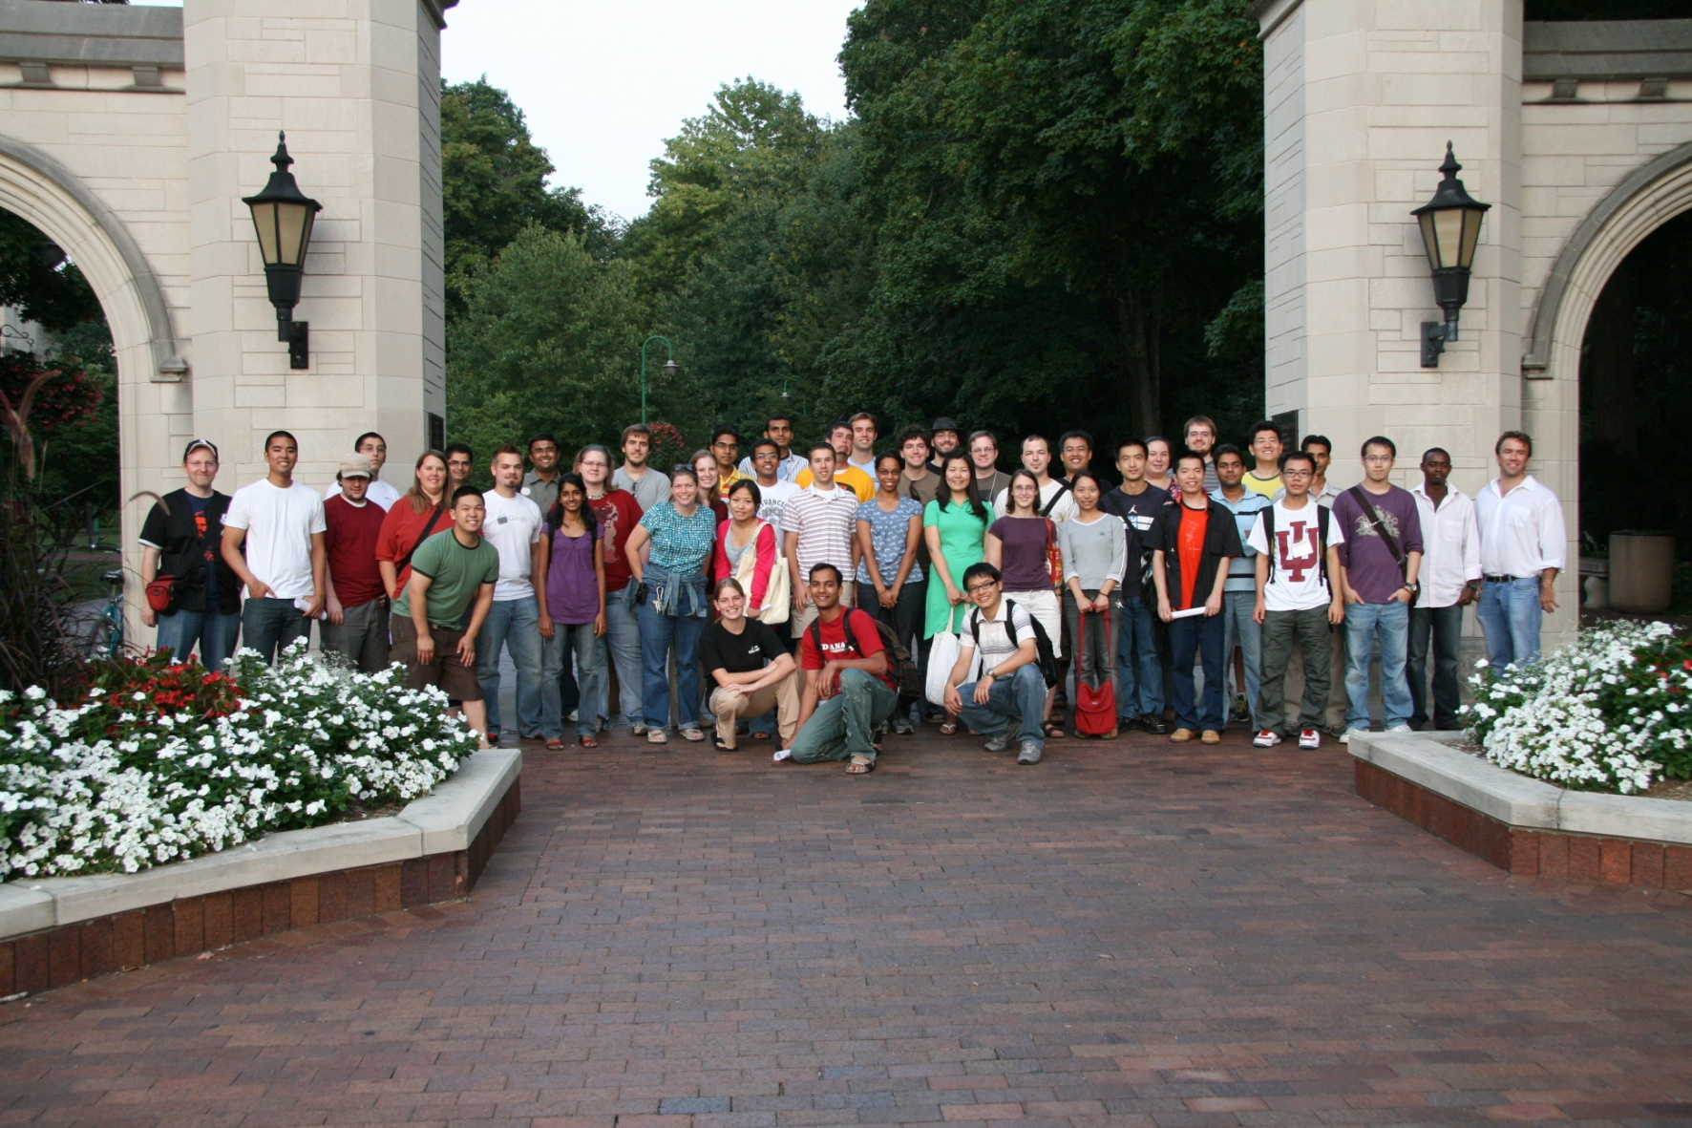
Bloomington is composed of different individuals from diverse backgrounds
http://www.facebook.com/photo.php?pid=1203188&op=1&o=global&view=global&subj=686176043&m=1&id=686176043
Predispositions | Research | Insights | Prototypes

Slide 4
People want to be part of a community
http://www.chicagononprofit.org/UserFiles/Image/logos/Community%20Building%20Tutors2.bmp
Predispositions | Research | Insights | Prototypes
Notes:
Many people want to be part of a community

Slide 5
"Culture is dynamic; multifaceted; embedded in context; influenced by social, economic, and political factors; created and socially constructed; learned; and dialectical.“
Nieto (1999)
Notes:
People are complex, different and unique and so is culture. There are a lot of places that try to implement diverse practice but they do so in token gestures. We seek to address a genuine acceptance of others and their cultures.

Slide 6
Diversity encompasses many different aspects of life
Race
Physical
Abilities
Age
Cultural
Ethnic
Sexual Orientation
Religion
Social
Economic
Gender
Predispositions | Research | Insights | Prototypes

Slide 7
Diversity encompasses many different aspects of life
Race
Physical
Abilities
Age
Cultural
Ethnic
Sexual Orientation
Religion
Social
Economic
Gender
Predispositions | Research | Insights | Prototypes

Slide 8
Study: high tolerance of racism
Acceptance of diversity remains an issue in our society
Downplayed by using jokes
Indifference to racism
Subdued Responses
York University. "Surprisingly High Tolerance For Racism Revealed." ScienceDaily 9 January 2009. 9 March 200. http://www.sciencedaily.com­ /releases/2009/01/090108144747.htm#.
Predispositions | Research | Insights | Prototypes
Notes:
The above is from Elizabeth Dunn, an expert on people's ability to predict their future emotional responses at York University
Actor A and B and C are in cahoots
Participant P and Actor A are sitting in a waiting room
Actor B walks in and bumps into Actor A and leaves.
Actor A says to Participant P “I hate it when bleep do that.”
Actor C calls them into the study room and asks if they are ready to proceed. 63% of Participant Ps will say yes.
If they saw it on a video they would be significantly less inclined to work with that person.

Slide 9
Factors in Hate Crimes
Acceptance of diversity remains an issue in our society
Federal Bureau of Investigation. Statistics on Hate Crimes for the Year 2007. 2007. Accessed 9 Mar 2009.
http://www.fbi.gov/ucr/hc2007/table_10.htm
Predispositions | Research | Insights | Prototypes

Slide 10
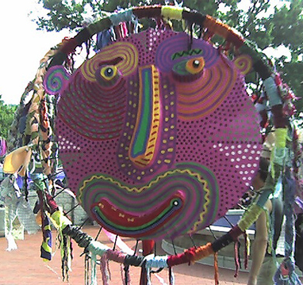
Diversity Can Promote Economic Growth
Diversity's Positive Impact
Lotus Festival, Bloomington IN
1994:
1000 Attendees
2005:
9000 Attendees
Estimated $150,000 economic impact (2005)
Bloomington City Government (2006). City Grants Lotus Funds For Free Family Event. 14 Sep 2006. Accessed 9 Mar 2009. http://bloomington.in.gov/documents/viewDocument.php?document_id=1209
Aethyric, http://www.flickr.com/photos/aethyric/62789724/
Predispositions | Research | Insights | Prototypes

Slide 11
Study: Diversity Enhances Education
Diversity's Positive Impact
Students who attended a college with a more diverse student population increased their:
Retention
Overall college satisfaction
Intellectual self-confidence
Social self-confidence
Chang, M. J. (1999a). Does racial diversity matter?: The educational impact of a racially diverse undergraduate population. Journal of College Student Development, 40(4), 377-395.
Predispositions | Research | Insights | Prototypes

Slide 12
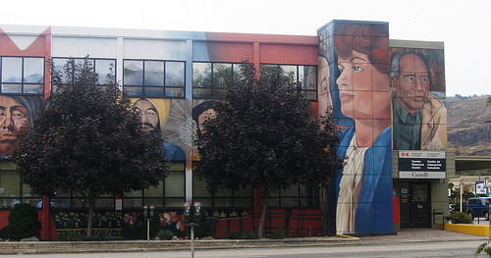
Creativity Has Been Used To Promote diversity
Diversity's Positive Impact
http://www.flickr.com/photos/diamonds_in_the_soles_of_her_shoes/2989801145/
Source: Poppy Lauretta McLeod, Sharon Alisa Lobel, & Taylor H. Cox, Jr. Ethnic Diversity & Creativity in Small Groups. Small Group Research, May 1996; 27: 248 - 264.
Predispositions | Research | Insights | Prototypes
Notes:
The use of digital artifacts to help promote diversity
Source: FUTURE POSSIBILITIES: A Scenario Analysis Study of British Television . Christine Daymon & Robin Foster

Slide 13
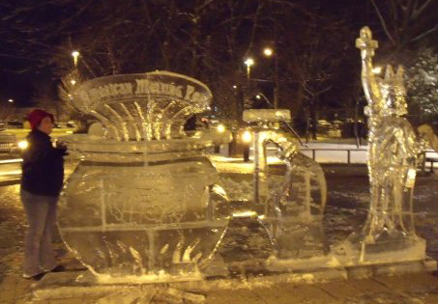
Public Art and the Community
Public art can bring the community together
E Pluribus Unum : Diversity and Community in the Twenty-first Century. The 2006 Johan Skytte Prize Lecture
http://www.facebook.com/photo.php?pid=1897151&op=1&o=global&view=global&subj=626836936&id=626836936
Predispositions | Research | Insights | Prototypes

Slide 14
Diversity is still an issue affecting society
Insights
Predispositions | Research | Insights | Prototypes

Slide 15
Diversity is still an issue affecting society
Insights
A community is benefitted by diversity
Predispositions | Research | Insights | Prototypes

Slide 16
Diversity is still an issue affecting society
Insights
A community is benefitted by diversity
Community can be fostered by technology
Predispositions | Research | Insights | Prototypes

Slide 17
Diversity is still an issue affecting society
Insights
A community is benefitted by diversity
Community can be fostered by technology
Public art can bring the community together
Predispositions | Research | Insights | Prototypes

Slide 18
Diversity is still an issue affecting society
Insights
A community is benefitted by diversity
Community can be fostered by technology
Public art can bring the community together
Diversity is a very personal and sensitive issue
Predispositions | Research | Insights | Prototypes

Slide 19
Two Prototype Categories
Prototypes
External Wayshowing
showing how to physically get around in the world
Predispositions | Research | Insights | Prototypes

Slide 20
Two Prototype Categories
External Wayshowing
showing how to physically get around in the world
Internal Wayshowing
showing how you are connected with the world
Predispositions | Research | Insights | Prototypes

Slide 21
prototype
Prototypes – External Wayshowing
Predispositions | Research | Insights | Prototypes

Slide 22
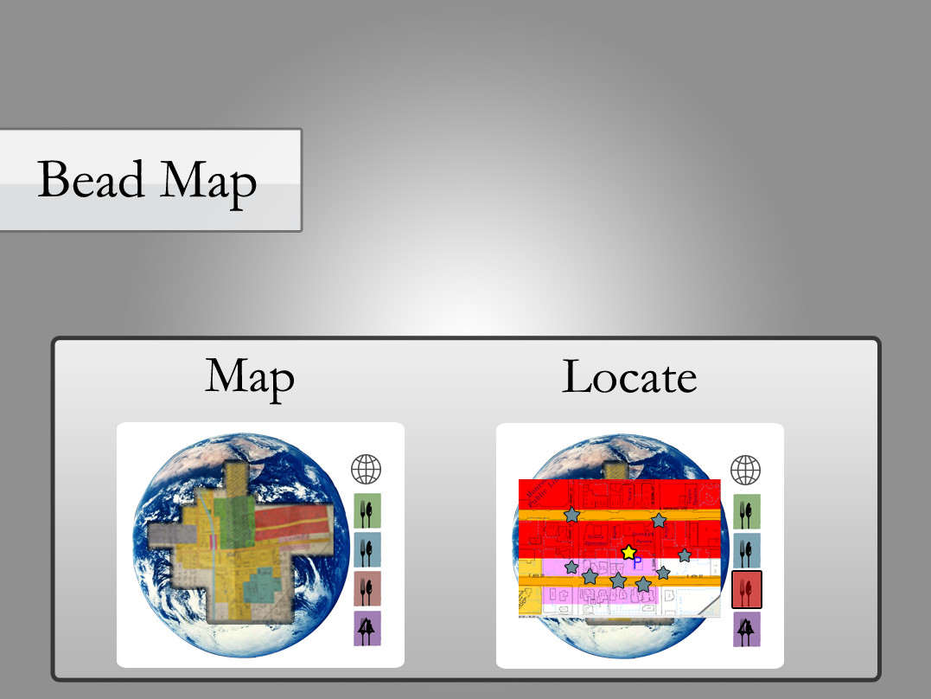
prototype
Prototypes – External Wayshowing
Predispositions | Research | Insights | Prototypes

Slide 23
Prototypes
Prototypes – External Wayshowing
Predispositions | Research | Insights | Prototypes

Slide 24
Prototypes – External Wayshowing
Predispositions | Research | Insights | Prototypes

Slide 25
prototype
Prototypes – External Wayshowing
Predispositions | Research | Insights | Prototypes

Slide 26
Prototypes – External Wayshowing
Predispositions | Research | Insights | Prototypes

Slide 27
Prototypes – External Wayshowing
Predispositions | Research | Insights | Prototypes

Slide 28
Prototypes – External Wayshowing
Predispositions | Research | Insights | Prototypes

Slide 29
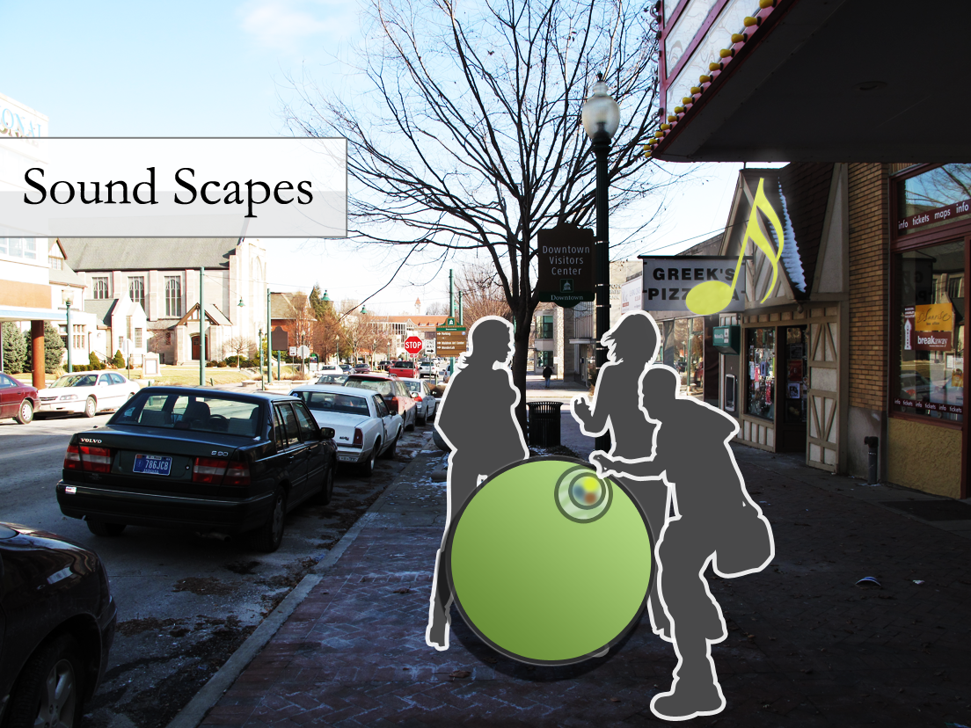
Prototypes – Internal Wayshowing
Predispositions | Research | Insights | Prototypes

Slide 30
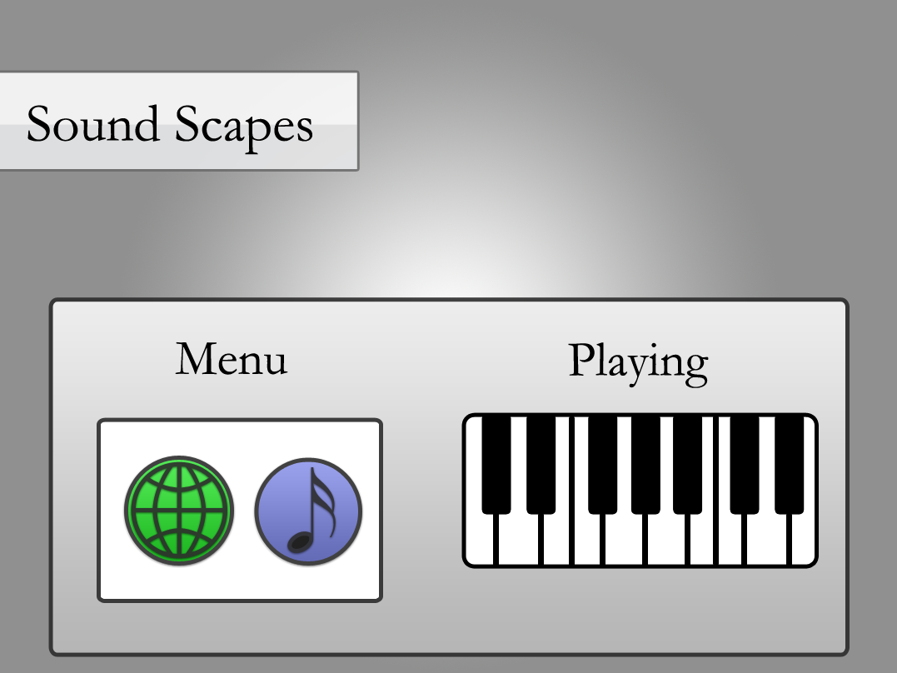
Prototypes – Internal Wayshowing
Predispositions | Research | Insights | Prototypes

Slide 31
Prototypes – Internal Wayshowing
Predispositions | Research | Insights | Prototypes

Slide 32
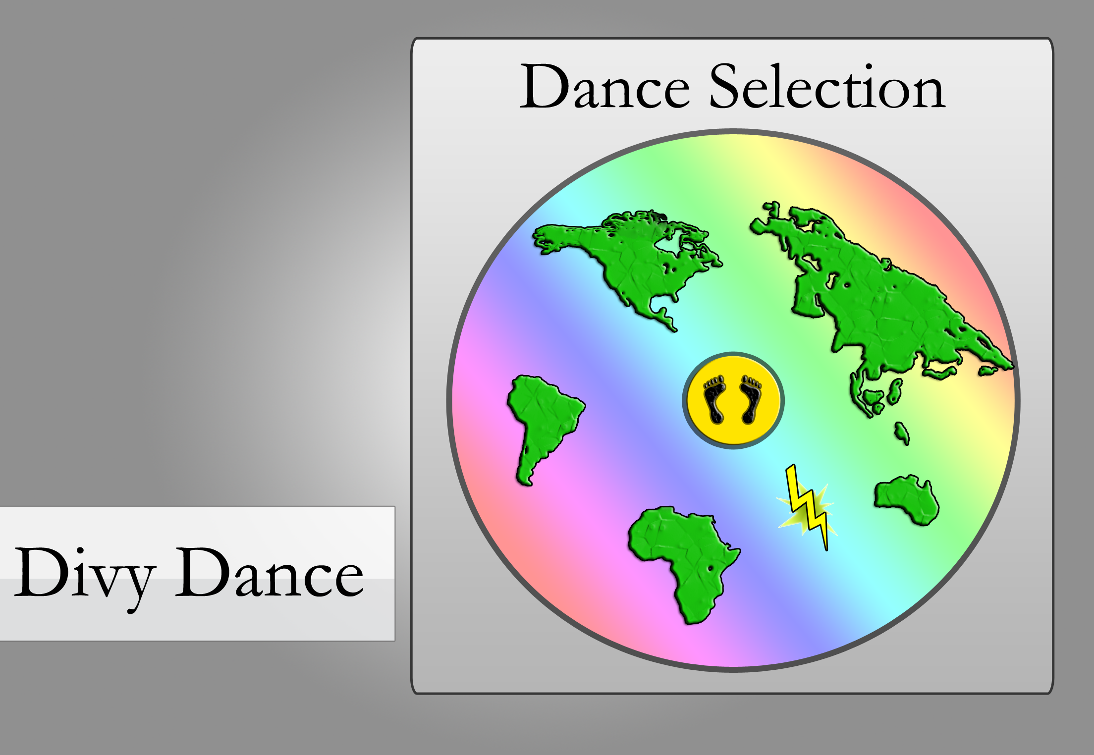
Prototypes – Internal Wayshowing
Predispositions | Research | Insights | Prototypes

Slide 33
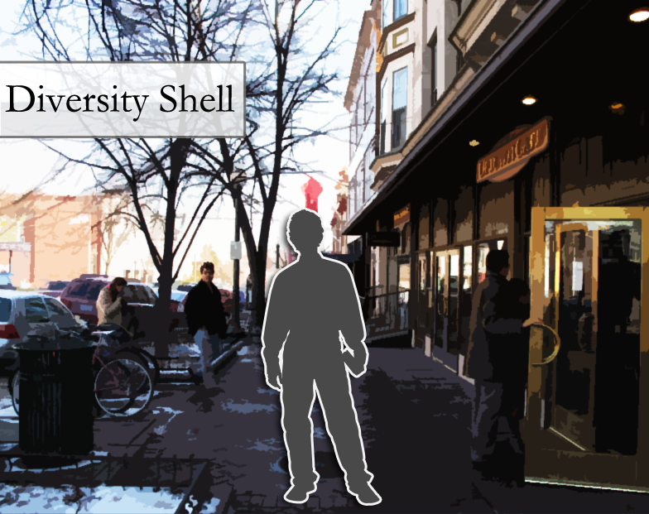
Prototypes – Internal Wayshowing
Predispositions | Research | Insights | Prototypes

Slide 34
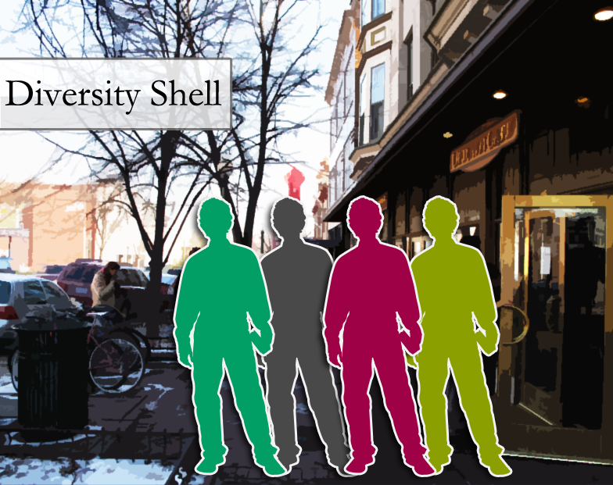
Prototypes – Internal Wayshowing
Predispositions | Research | Insights | Prototypes

Slide 35
Prototypes – Internal Wayshowing
Predispositions | Research | Insights | Prototypes

Slide 36
Prototypes – Internal Wayshowing
Predispositions | Research | Insights | Prototypes

Slide 37
Prototypes – Internal Wayshowing
Predispositions | Research | Insights | Prototypes

Slide 38
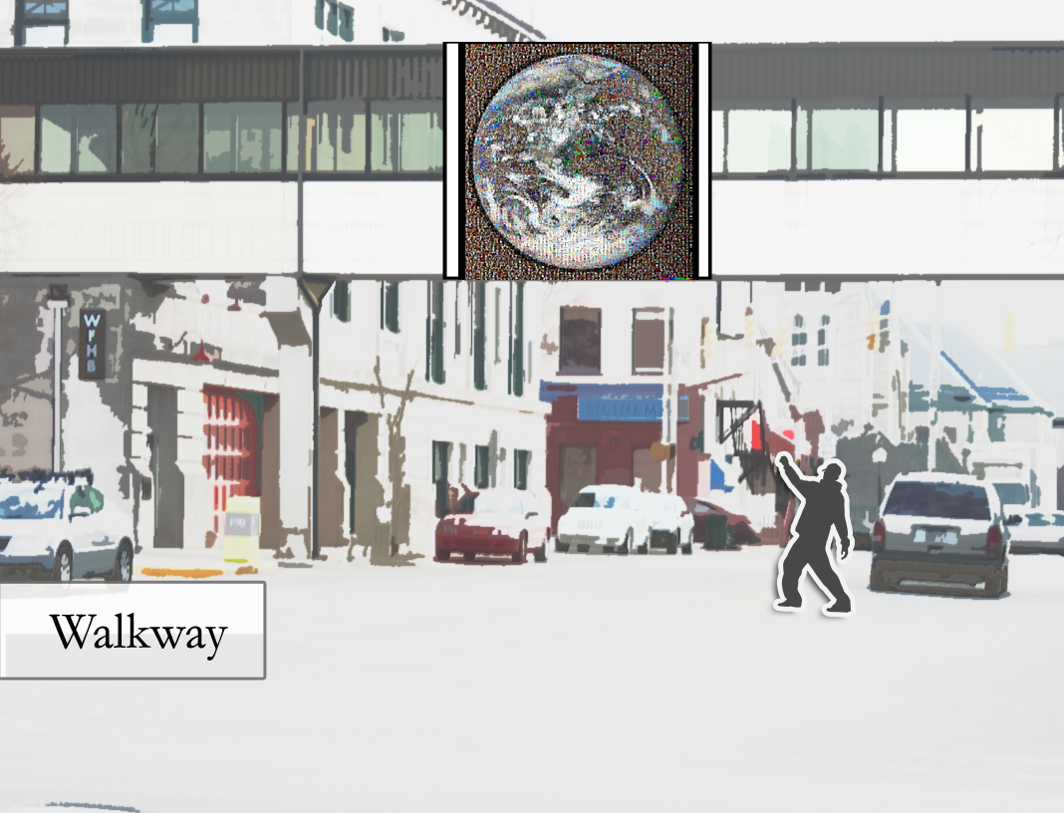
Prototypes – Internal Wayshowing
Predispositions | Research | Insights | Prototypes

Slide 39
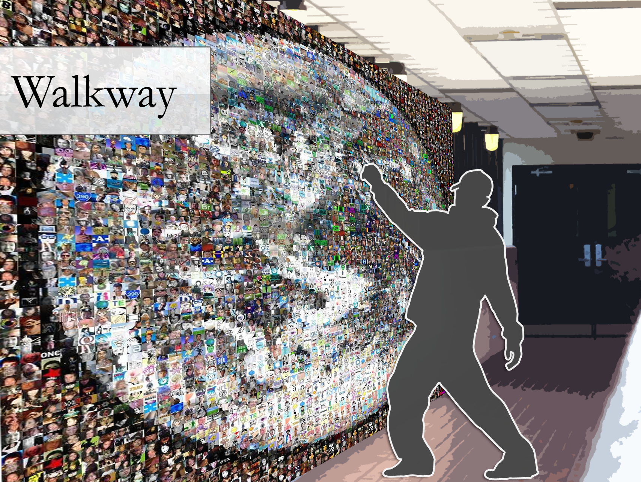
Prototypes – Internal Wayshowing
Predispositions | Research | Insights | Prototypes

Slide 40
Prototypes – Internal Wayshowing
Predispositions | Research | Insights | Prototypes

Slide 41
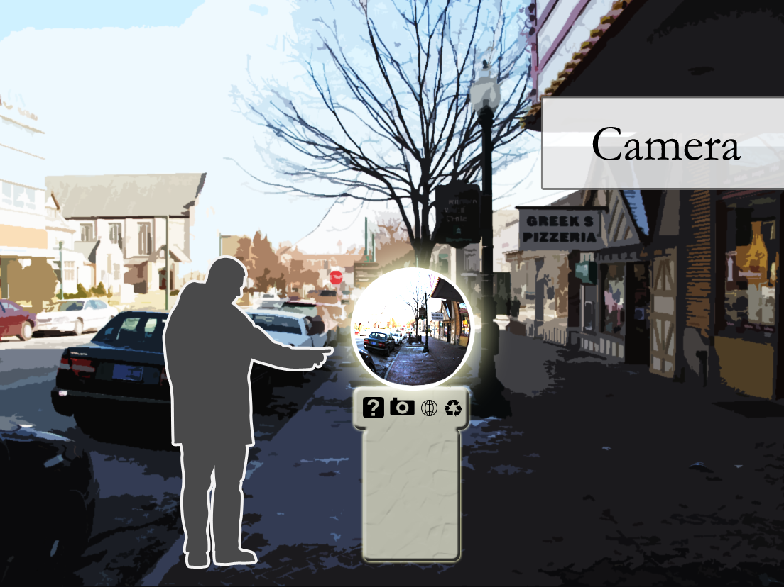
Prototypes – Internal Wayshowing
Predispositions | Research | Insights | Prototypes

Slide 42
Thank You!
?

Slide 44
Art in Public Places Can Help Communities Heal
Examples of Public Interactions
http://blog.templates.com/public-art-astonishing-ideas/

Slide 45
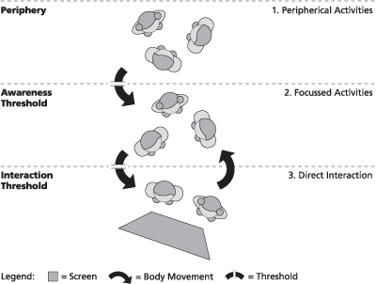
Perception and Usage of Interactive Displays
Comfort Zones of Interaction
Daniel Michelis (2009), according to: Brignull & Rogers, 2003. http://magicalmirrors2006.wordpress.com/2008/07/02/interactive-displays-perception-awareness-and-interaction/
Notes:
http://magicalmirrors2006.wordpress.com/2008/07/02/interactive-displays-perception-awareness-and-interaction/
(Source: Daniel Michelis (2009), according to: Brignull & Rogers, 2003)

Slide 46
Diversity Helps Economic Prosperity
Diversity’s Positive Impact
Austin, TX
Edmonton, Canada
Salt Lake City, UT
Rochester, NY
http://www.brookings.edu/speeches/2008/0212_rochester_katz.aspx?rssid=cities
Notes:
Austin:
May 2000 Austin Design Guidelines
http://www.ci.austin.tx.us/downtown/downloads/dg012-020.pdf
Edmonton: http://imagesedmonton.com/index.php/site/articles/business/edmonton_companies_stand_out_for_promoting_workplace_diversity
Salt Lake City, Utah:
http://www.downtownslc.org/
Rochester, NY:
http://www.brookings.edu/speeches/2008/0212_rochester_katz.aspx?rssid=cities

Slide 47
Diversity Can Create Better Doctors
Diversity’s Positive Impact
University of California - Los Angeles. "Diversity At Medical Schools Makes Stronger Doctors, Study Shows." ScienceDaily 10 September 2008. 9 March 2009 http://www.sciencedaily.com­ /releases/2008/09/080909205615.htm.
Notes:
University of California - Los Angeles. "Diversity At Medical Schools Makes Stronger Doctors, Study Shows." ScienceDaily 10 September 2008. 9 March 2009 http://www.sciencedaily.com­ /releases/2008/09/080909205615.htm.

Slide 48
Affirmative Action and Diversity
Acceptance of diversity remains an issue in our society
States have started to ban affirmative action, as it is a form of “reverse discrimination”
Gutierrez-Jones, Carl. Affirmative Action or Reverse Discrimination: Trick or Treat?. 31 Oct 2001. Accessed 20 Apr 2009.
http://aad.english.ucsb.edu/docs/tebaker.html
Predispositions | Research | Insights | Prototypes
Notes:
Florida, Michigan Proposal 2 http://en.wikipedia.org/wiki/Michigan_Civil_Rights_Initiative, Washington, California Proposition 209 http://en.wikipedia.org/wiki/Proposition_209
http://en.wikipedia.org/wiki/Ward_Connerly

Slide 49
Affirmative Action and Diversity
Acceptance of diversity remains an issue in our society
States have started to ban affirmative action, as it is a form of “reverse discrimination”
Americans have mixed feelings about the efficacy of this process
ABC News/Washington Poll. Race and Ethnicity. 13-16 Jan 2009. Accessed 20 Apr 2009.
http://www.pollingreport.com/race.htm
Predispositions | Research | Insights | Prototypes
Notes:
Other figures:
http://kansasprogress.com/wordpress/index.php/2009/03/04/poll-41-say-affirmative-action-no-longer-relevant/
http://www.puaf.umd.edu/IPPP/1QQ.HTM
http://www.insidehighered.com/news/2005/06/07/affirm

Slide 50
Affirmative Action and Diversity
Acceptance of diversity remains an issue in our society
States have started to ban affirmative action, as it is a form of “reverse discrimination”
Americans have mixed feelings about the efficacy of this process
This process has been questioned as to how it benefits collegiate diversity
Quiñones, Eric.
Ending affirmative action would devastate most minority college enrollment.
6 Jun 2005. Accessed 20 Apr 2009.
http://www.princeton.edu/main/news/archive/S11/80/78Q19/index.xml?section=newsreleases
Predispositions | Research | Insights | Prototypes
Notes:
http://www.lib.umich.edu/govdocs/affirm.html
http://inteldis.wordpress.com/2007/12/31/affirmative-action-again/

